Slide 1
Chapter 4: Correlation and Linear Regression
1

Slide 2
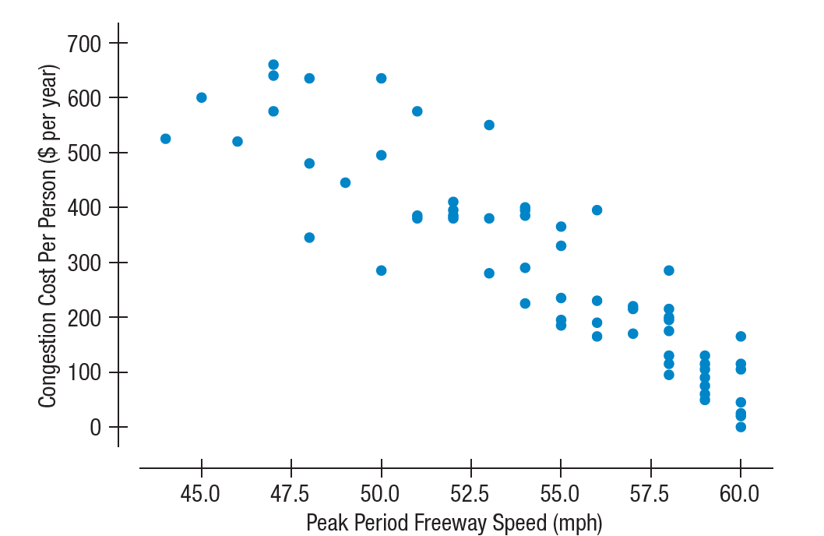
4.1 Looking at Scatterplots
A scatterplot, which plots one quantitative variable against another, is an effective display to look for trends, patterns, and relationships between two quantitative variables.
Scatterplots are the ideal way to picture associations between two quantitative variables.

Slide 3
4.1 Looking at Scatterplots
The direction of the association is important.
A pattern that runs from the upper left to the lower right is said to be negative.
A pattern running from the lower left to the upper right is called positive.

Slide 4
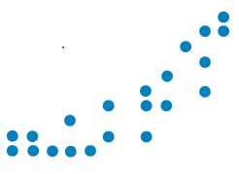
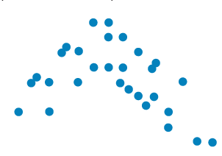
4.1 Looking at Scatterplots
The second thing to look for in a scatterplot is its form.
If there is a straight line relationship, it will appear as a cloud or swarm of points stretched out in a generally
consistent, straight form. This is called linear form.
Sometimes the relationship curves gently, while still increasing or decreasing steadily;
sometimes it curves sharply up then down.

Slide 5
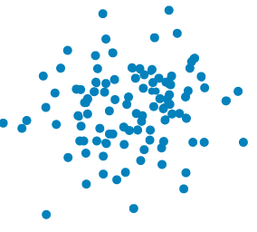
4.1 Looking at Scatterplots
At one extreme, do the points appear tightly clustered in a single stream (whether straight, curved, or bending all over the place)?
Or, at the other extreme, do the points seem to be so variable and spread out that we can barely discern any trend or pattern?

Slide 6
4.1 Looking at Scatterplots
At one extreme, do the points appear tightly clustered in a single stream (whether straight, curved, or bending all over the place)?
Or, at the other extreme, do the points seem to be so variable and spread out that we can barely discern any trend or pattern?

Slide 7
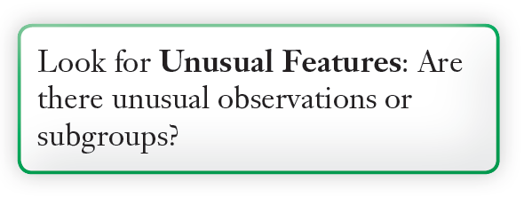
4.1 Looking at Scatterplots
Finally, always look for the unexpected.
An outlier is an unusual observation, standing away from the overall pattern of the scatterplot.

Slide 8
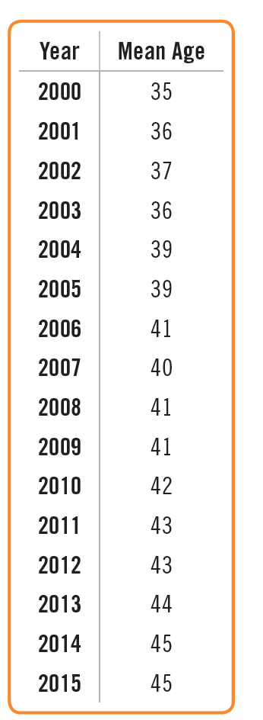
4.1 Looking at Scatterplots
Example: Age of Cyclists
Here’s data on the mean age of cyclists killed each year since 2000. Make a scatterplot and summarize what it says.

Slide 9
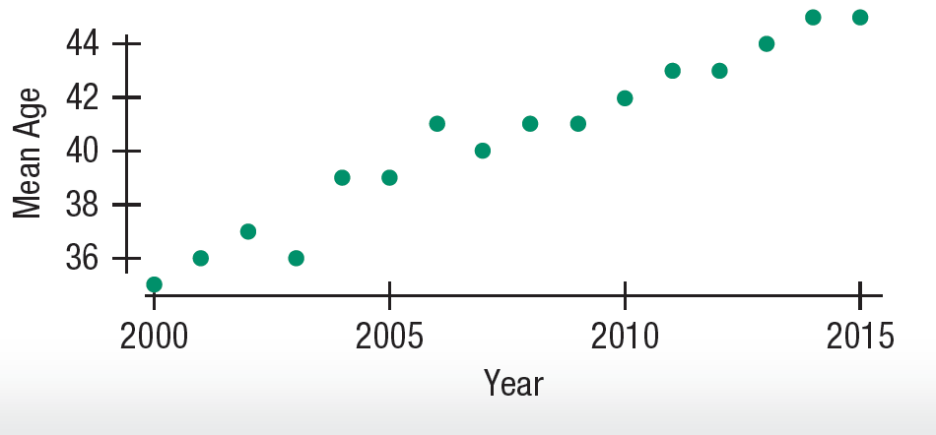
4.1 Looking at Scatterplots
Example: Age of Cyclists
The mean age of cyclist traffic deaths has been increasing almost linearly during the period. The trend is a strong one.

Slide 10
4.1 Looking at Scatterplots
Example: Age of Cyclists
The mean age of cyclist traffic deaths has been increasing almost linearly during the period. The trend is a strong one.

Slide 11
4.2 Assigning Roles to Variables in Scatterplots
To make a scatterplot of two quantitative variables, assign one to the y-axis and the other to the x-axis.
Be sure to label the axes clearly, and indicate the scales of the axes with numbers.
Each variable has units, and these should appear with the display—usually near each axis.

Slide 12
4.2 Assigning Roles to Variables in Scatterplots
Each point is placed on a scatterplot at a position that corresponds to values of the two variables.
The point’s horizontal location is specified by its x-value, and its vertical location is specified by its y-value variable.
Together, these variables are known as coordinates and written (x, y).

Slide 13
4.2 Assigning Roles to Variables in Scatterplots
One variable plays the role of the explanatory or predictor variable, while the other takes on the role of the response variable.
We place the explanatory variable on the x-axis and the response variable on the y-axis.
The x- and y-variables are sometimes referred to as the independent and dependent variables, respectively.

Slide 14
4.2 Assigning Roles to Variables in Scatterplots
One variable plays the role of the explanatory or predictor variable, while the other takes on the role of the response variable.
We place the explanatory variable on the x-axis and the response variable on the y-axis.
The x- and y-variables are sometimes referred to as the independent and dependent variables, respectively.

Slide 15
4.2 Assigning Roles to Variables in Scatterplots
Example: Age of Cyclists
When examining the ages of victims in cycle/car accidents, why does it make sense to plot year on the x-axis and mean age on the y-axis?

Slide 16
4.2 Assigning Roles to Variables in Scatterplots
Example: Age of Cyclists
To see how the age of accident victims might change over time, the year is the basis for prediction and the mean age of victims is the variable that is predicted.

Slide 17
4.3 Understanding Correlation
When two quantitative variables have a linear association, a measure of “how strong is the association” is needed.
This measure should not depend on units for the variable, so standardized values are used.
Since x’s and y’s are paired, multiply each standardized value of x by the standardized value it is paired with and add up those crossproducts. Divide by n -1.
The ratio of the sum of the product z_{x}z_{y} for every point in the scatterplot to n – 1
is called the correlation coefficient.

Slide 18
4.3 Understanding Correlation
Correlation Conditions
Correlation measures the strength of the linear association between two quantitative variables. Before using correlation, you must check three conditions:

Slide 19
4.3 Understanding Correlation
Correlation Conditions
Quantitative Variables Condition: Correlation applies only to quantitative variables.
Linearity Condition: Correlation measures the strength only of the linear association. If the underlying relationship is curved, summarizing its strength with a correlation would be misleading.
Outlier Condition: Unusual observations can distort the correlation. When you see an outlier, it’s often a good idea to report the correlation both with and without the point.

Slide 20
4.3 Understanding Correlation
Correlation Properties
The sign of a correlation coefficient gives the direction of the association.
Correlation is always between –1 and +1. It can be exactly –1 or +1, but these values are unusual because it means all of the data points fall exactly on a straight line.
Correlation treats x and y symmetrically.
Correlation has no units.

Slide 21
4.3 Understanding Correlation
Correlation Properties
Correlation is not affected by changes in the center or scale of either variable.
Correlation measures the strength of the linear association between the two variables.
Correlation is sensitive to unusual observations.

Slide 22
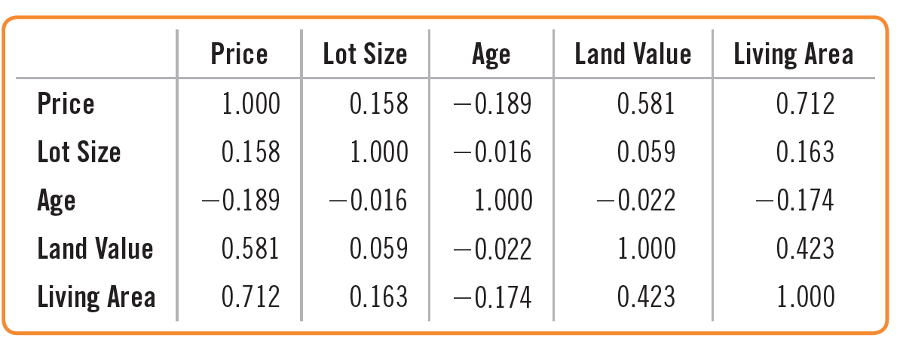
4.3 Understanding Correlation
Correlation Tables
Sometimes the correlations between each pair of variables in a data set are arranged in a table like the one below.

Slide 23
4.3 Understanding Correlation
Correlation Tables
Sometimes you’ll see the correlations between each pair of variables in a dataset arranged in a table. The rows and columns of the table name the variables, and the
cells hold the correlations.

Slide 24
4.4 Lurking Variables and Causation
There is no way to conclude from a high correlation alone
that one variable causes the other.
There’s always the possibility that some third variable—a lurking variable—is simultaneously affecting both of the variables you have observed.

Slide 25
4.4 Lurking Variables and Causation
Should we send more doctors to developing countries to increase life expectancy?
No. Countries with higher standards of living have both longer life expectancies and more doctors.
Higher standard of living is a lurking variable.
Resist the temptation to conclude that x causes y from a correlation, no matter how obvious the conclusion may seen.

Slide 26
4.4 Lurking Variables and Causation
Example: Age of Cyclists
An insurance company analyst suggests that the data on ages of cyclist accident deaths are actually due to the entire population of cyclists getting older and
not to a change in the safe riding habits of older cyclists.
It seems like older
riders might be riding less safely than they used to. Can I conclude that from the strong correlation?

Slide 27
4.4 Lurking Variables and Causation
Example: Age of Cyclists
No. You don’t have data on the safety record of each age group. If the entire population of cyclists is aging then that would lead to the average age of cyclists in
accidents increasing. In this case, the mean age of all cyclists is really a lurking variable.

Slide 28
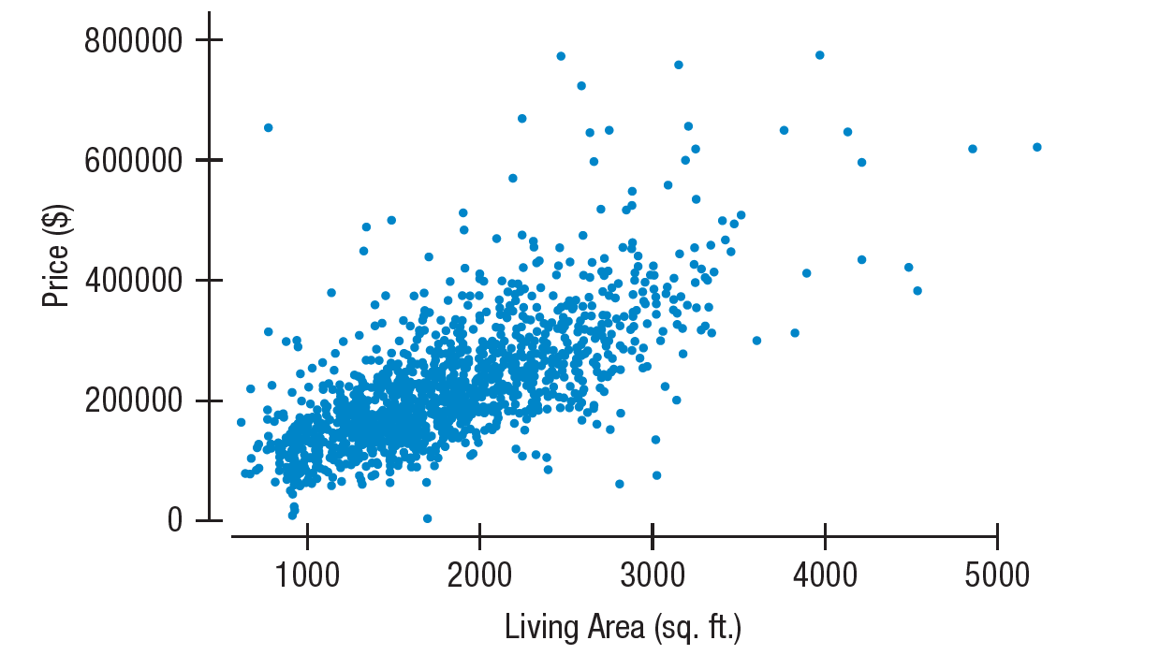
4.5 The Linear Model
Let’s return to the relationship between house price and size. We see a moderate, positive, linear relationship, so we can summarize its strength with a correlation. For this relationship, the correlation is 0.712.

Slide 29
4.5 The Linear Model
We can model the relationship with a line and give the equation.
Specifically, we can find a linear model to describe the relationship we saw between Price and Weight.
A linear model is just an equation of a straight line through the data.
The points in the scatterplot don’t all line up, but a straight line can summarize the general pattern with only a few parameters.

Slide 30
4.5 The Linear Model
Residuals
We know the model won’t be perfect.
No matter what line we draw, it won’t go through many of the points.
Our question now is how to find the right line.

Slide 31
4.5 The Linear Model
Residuals
A linear model can be written in the form where b₀ and b₁ are numbers estimated from the data and is the predicted value.
The difference between the predicted value and the observed value, y, is called the residual and is denoted e.

Slide 32
4.5 The Linear Model
The Line of “Best Fit”
Some residuals will be positive and some negative, so adding up all the residuals is not a good assessment of how well the line fits the data.
If we consider the sum of the squares of the residuals, then the smaller the sum, the better the fit.
The line of best fit is the line for which the sum of the squared residuals is smallest – often called the least squares line.

Slide 33
4.6 Correlation and the Line
Straight lines can be written as
The scatterplot of real data won’t fall exactly on a line so we denote the model of predicted values by the equation
But if the model is a good one, the data values will scatter closely around it.
The “hat” on the y will be used to represent an approximate, or predicted, value.

Slide 34
4.6 Correlation and the Line
For the Saratoga house data, the line is:
The slope, 113.12, says that we can expect a house that’s one square foot bigger will be worth, on average, about $113.12 more.

Slide 35
4.6 Correlation and the Line
For the Saratoga house data, the line is:
The intercept of $13,439 is the value of the line when the x-variable is zero.
There are no empty lots in our data. The smallest house is 616 sq. ft. Intercepts often have no physical meaning and just serve as the starting point for the model.

Slide 36
4.6 Correlation and the Line
We can find the slope of the least squares line using the correlation and the standard deviations.
The slope gets its sign from the correlation. If the correlation is positive, the scatterplot runs from lower left to upper right and the slope of the line is positive.
The slope gets its units from the ratio of the two standard deviations, so the units of the slope are a ratio of the units of the variables.

Slide 37
4.6 Correlation and the Line
To find the intercept of our line, we use the means. If our line estimates the data, then it should predict for the x-value
Thus we get the following relationship from our line.
We can now solve this equation for the intercept to obtain the formula for the intercept.

Slide 38
4.6 Correlation and the Line
It’s easy to use the estimated linear model to predict the price of a house from its size.
Consider, for example, a 3000 sq. ft. house at 100 Garnsey Lane in Schuylerville, NY, found on Zillow in July 2017. Our model predicts its price as:

Slide 39
4.6 Correlation and the Line
In fact, the house’s asking price is $364,500.
The difference between the observed value and the value predicted by the regression equation, the residual, is

Slide 40
4.6 Correlation and the Line
Least squares lines are commonly called regression lines. We’ll need to check the same condition for regression as we did for correlation.
Quantitative Variables Condition
Linearity Condition
Outlier Condition

Slide 41
4.6 Correlation and the Line
Understanding Regression from Correlation
What happens to the regression equation if we standardize both the predictorand response variables and regress
z_{x} and z_{y}? Standardized variables have standard
deviation = 1 and mean = 0.
So, the slope is
and the intercept is 0 (because both and are now 0).

Slide 42
4.6 Correlation and the Line
Understanding Regression from Correlation
From the values for slope and intercept for the standardized variables, we may rewrite the regression equation.
From this we see that for an observation 1 SD above the mean in x, you’d expect y to have a z-score of r.

Slide 43
4.6 Correlation and the Line
Understanding Regression from Correlation
For the Saratoga houses, the correlation is 0.712.
We can now express the relationship for the standardized variables.
That means that a house that is one standard deviation bigger than the mean house, about 620 sq feet, is predicted by our model to cost about 0.712 standard deviation or $70,000 more than the mean house.

Slide 44
4.7 Regression to the Mean
The equation below shows that if x is 2 SDs above its mean, we won’t ever move more than 2 SDs away for y, since r can’t be bigger than 1.
So, each predicted y tends to be closer to its mean than its corresponding x was.
This property of the linear model is called regression to the mean.

Slide 45
4.8 Checking the Model
Models are useful only when specific assumptions are reasonable. We check conditions that provide information about the assumptions.
Quantitative Data Condition – linear models only make sense for quantitative data, so don’t be fooled by categorical data recorded as numbers.
Linearity Assumption – check Linearity Condition – two variables must have a linear association, or a linear model won’t mean a thing.
Outlier Condition – outliers can dramatically change a regression model.
Equal Spread Condition – check a residual plot for equal scatter for all x-values.

Slide 46
4.8 Checking the Model
The residuals are the part of the data that hasn’t been modeled.
We have written this in symbols previously.

Slide 47
4.8 Checking the Model
Residuals help us see whether the model makes sense.
A scatterplot of residuals against predicted values should show nothing interesting – no patterns, no direction, no shape.
If nonlinearities, outliers, or clusters in the residuals are seen, then we must try to determine what the regression model missed.

Slide 48
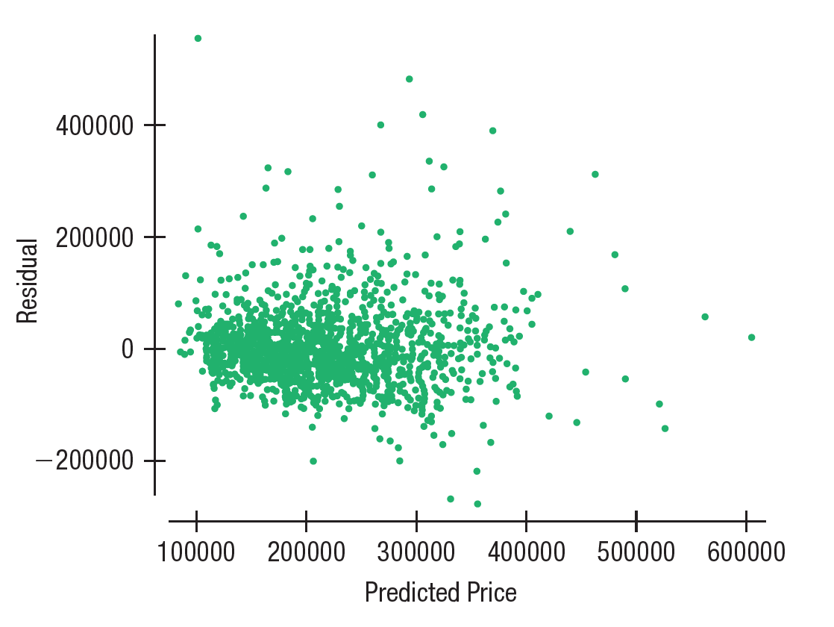
4.8 Checking the Model
For house prices on living area, here are the residuals plotted against the predicted values:
There are no patterns or interesting features, so a linear model makes sense

Slide 49
4.8 Checking the Model
The standard deviation of the residuals, s_{e}, gives us a measure of how much the points vary around the regression line.
We estimate the standard deviation of the residuals as shown below.
The standard deviation around the line should be the same wherever we apply the model – this is called the Equal Spread Condition.

Slide 50
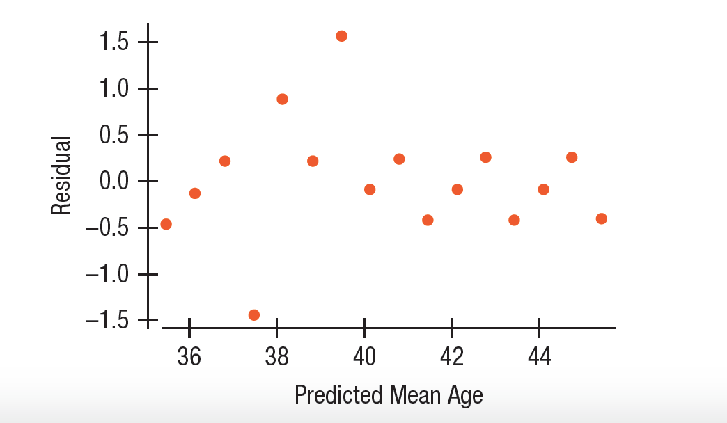
4.8 Checking the Model
Example: Age of Cyclists
Did you assess your model of cyclists’ ages on year to see if the assumptions were reasonable?

Slide 51
4.8 Checking the Model
Example: Age of Cyclists
The residuals show no pattern, as you can see from the plot of residuals vs. predicted values. There is one point that seems somewhat low,
but it does not unduly affect the model and the model appears to be reasonable.

Slide 52
4.9 Variation in the Model and R²
The variation in the residuals is the key to assessing how well a model fits.
If the correlation were 1.0, then the model predicts y perfectly, the residuals would all be zero and have no variation.
If the correlation were 0, the model would predict the mean for all x-values. The residuals would have the same variability as the original data.

Slide 53
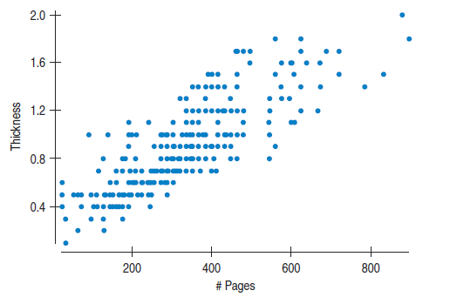
4.9 Variation in the Model and R²
How is the thickness of a book related to the number of pages?
We certainly expect
books with more pages to be thicker, but can we find a model to relate these two variables?
Here’s a scatterplot of the data:

Slide 54
4.9 Variation in the Model and R²
The model is
which says that a book starts out about 0.29 inches thick (covers?) and then have about 0.00183 inches per page of thickness.

Slide 55
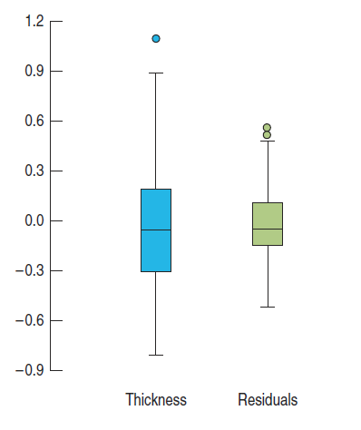
4.9 Variation in the Model and R²
We can see that the residuals vary less than the original thickness values did.
Consider the total amount of variation displayed in both graphs.
If you had to put a number between 0% and 100% on the fraction of variation left in the residuals, what would you guess?

Slide 56
4.9 Variation in the Model and R²
We can construct a measure that tells us where our model falls between being perfect and being useless.

Slide 57
4.9 Variation in the Model and R²
All regression models fall somewhere between the two extremes of zero correlation or perfect correlation of plus or minus 1.
We consider the square of the correlation coefficient r to get r² which is a value between 0 and 1.
r² gives the fraction of the data’s variation accounted for by the model and 1 – r² is the fraction of the original variation left in the residuals.

Slide 58
4.9 Variation in the Model and R²
r² by tradition is written R² and called “R squared”.
The variance of Thickness is 0.136.
The variance of the residuals is 0.0458.
That’s 0.0458/0.136 = 0.3367 or 33.67%
of the variance of Thickness left behind in the residuals.

Slide 59
4.9 Variation in the Model and R²
How Big Should R² Be?
There is no value of R² that automatically determines that a regression is “good”.
Data from scientific experiments often have R² in the 80% to 90% range.
Data from observational studies may have an acceptable R² in the 30% to 50% range.

Slide 60
4.9 Variation in the Model and R²
Example: Cyclists
What’s the R² for the regression of cyclist death ages vs. time that you found previously? And what exactly does it mean?

Slide 61
4.9 Variation in the Model and R²
Example: Cyclists
We are given the correlation, r = 0.979. R² is the square of this, or 0.958. It tells us that 96% of the variation in the mean age of cyclist deaths can be accounted for by the trend of increasing age over time.

Slide 62
4.10 Reality Check: Is the Regression Reasonable?
The results of a statistical analysis should reinforce common sense.
Is the slope reasonable?
Does the direction of the slope seem right?
Always be skeptical and ask yourself if the answer is reasonable.

Slide 63
4.11 Nonlinear Relationships
Everything discussed in chapter 4 requires the underlying relationship to be linear. If the relationship is not linear, there are three basic approaches, each with advantages and disadvantages.

Slide 64
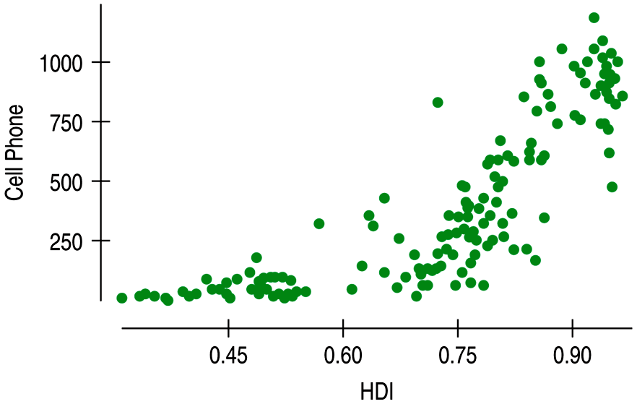
4.11 Nonlinear Relationships
The Human Development Index (HDI) combines economic information, life expectancy, and education to provide a general measure of quality of life.
Consider cell phone growth vs. HDI for 152 countries of the world. The scatterplot reveals a nonlinear relationship that is not appropriate for linear regression.

Slide 65
4.11 Nonlinear Relationships
You might think that we should just fit some curved function such as an exponential or quadratic to a shape like this.
But using curved functions is complicated, and the resulting model can be difficult to interpret.
This approach isn’t often
used.

Slide 66
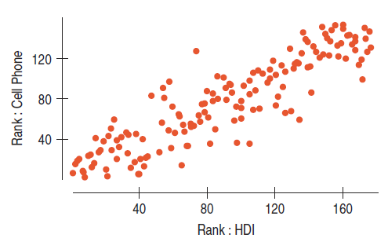
4.11 Nonlinear Relationships
Another approach allows us to summarize the strength of the association between the variables even when we don’t have a linear relationship. The Spearman rank correlation works with the ranks of the data rather than their values.

Slide 67
4.11 Nonlinear Relationships
Now we can calculate a correlation on the ranks. The resulting correlation summarizes the degree of relationship between two variables—but not, of course, of the degree of linear relationship. The Spearman correlation for these variables is 0.876.

Slide 68
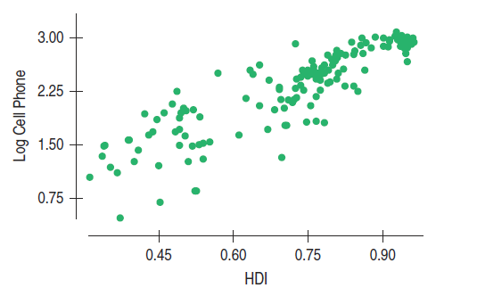
4.11 Nonlinear Relationships
A third approach to a nonlinear relationship is to transform or re-express one or both of the variables by a function such as the square root, logarithm, or reciprocal. Logs of the number of Cell Phones were taken:

Slide 69
4.11 Nonlinear Relationships
The advantage of re-expressing variables is that we can use regression models, along with all the supporting statistics still to come.
The disadvantage is that we must interpret our results in terms of the re-expressed data, and it can be difficult to explain what we mean by the logarithm of the number of cell phones in a country.

Slide 70
4.12 Multiple Regression—A Glimpse Ahead
With today’s software, fitting a multiple regression model is no more difficult than fitting a simple linear model, but with more predictors multiple regression models are useful in far more real situations.
Because they are so important, so
powerful, and so common in business analysis, we’ll devote Chapters 18 and 19 to multiple regression.
However, like simple regression models, they can be misused and misinterpreted, issues that we’ll discuss in great detail later.

Slide 71
WHAT CAN GO WRONG?
Don’t say “correlation” when you mean “association.”
Don’t correlate categorical variables.
Make sure the association is linear.
Beware of outliers.
Don’t confuse correlation with causation.
Watch out for lurking variables.

Slide 72
WHAT CAN GO WRONG?
Don’t fit a straight line to a nonlinear relationship.
Beware of extraordinary points.
Don’t predict far beyond the data. A linear model will often do a reasonable job of summarizing a relationship in the range of the observed x-values.
Don’t choose a model based on R² alone.

Slide 73
FROM LEARNING TO EARNING
Make a scatterplot to display the relationship between two quantitative variables.
• Look at the direction, form, and strength of the relationship, and any outliers that stand away from the overall pattern.

Slide 74
FROM LEARNING TO EARNING
Provided the form of the relationship is linear, summarize its strength with a correlation, r.
The sign of the correlation gives the direction of the relationship.
-1 $≤$ r $≤$ 1; a correlation of 1 or -1 is a perfect linear relationship. A correlation of 0 is a lack of linear relationship.
Correlation has no units, so shifting or scaling the data, standardizing, or even swapping the variables has no effect on the numerical value.
A large correlation is not a sign of a causal relationship.

Slide 75
FROM LEARNING TO EARNING
Model a linear relationship with a least squares regression model.
The regression (best fit) line doesn’t pass through all the points, but it is the best compromise in the sense that the sum of squares of the residuals is the smallest possible.
The slope tells us the change in y per unit change in x.
The R² gives the fraction of the variation in y accounted for by the linear regression model.

Slide 76
FROM LEARNING TO EARNING
Recognize regression to the mean when it occurs in data.
• A deviation of one standard deviation from the mean in one variable is predicted to correspond to a deviation of r standard deviations from the mean in the other. Because r is never more than 1, we predict a change toward the mean.

Slide 77
FROM LEARNING TO EARNING
Examine the residuals from a linear model to assess the quality of the model.
When plotted against the predicted values, the residuals should show no pattern and no change in spread.

