Slide 1

Chapter 2:
Visualizing and Describing Categorical Data
1

Slide 2
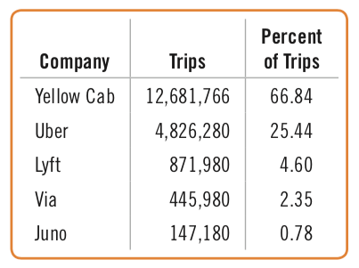
2.1 Summarizing a Categorical Variable
A frequency table records the counts for each of the categories of a categorical variable, as in the table below.
Some tables reports percentages instead of counts, and many report both.

Slide 3
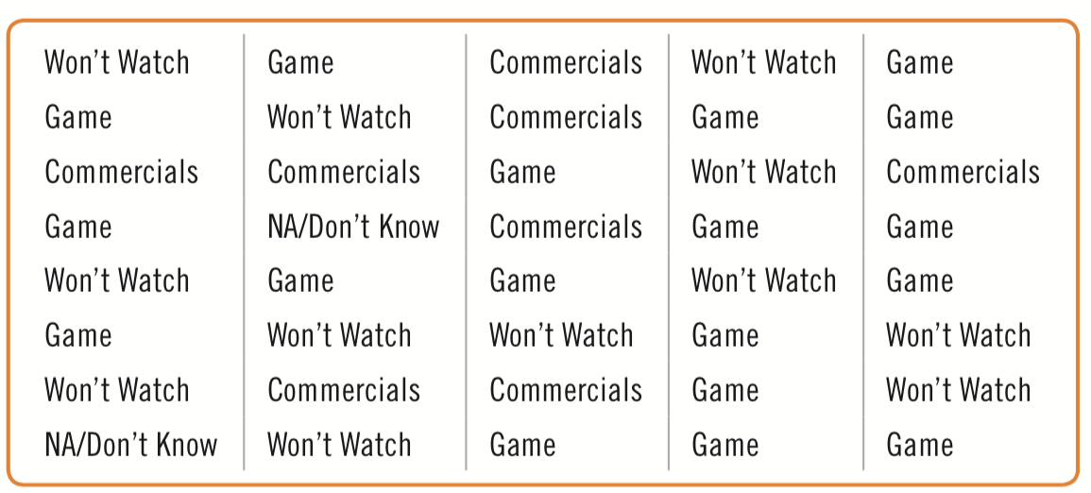
2.1 Summarizing a Categorical Variable
Example: Gaining Insights from Counts
The Super Bowl, the championship game of the National Football League of the United States, is an important annual social event for Americans, with tens of millions of viewers. The ads that air during the game are expensive: a 30-second ad during the 2013 Super Bowl cost about $5 to $5.5 million.
Polls often ask whether respondents are more interested in the game or the commercials. Here are 40 responses from one such poll.

Slide 4
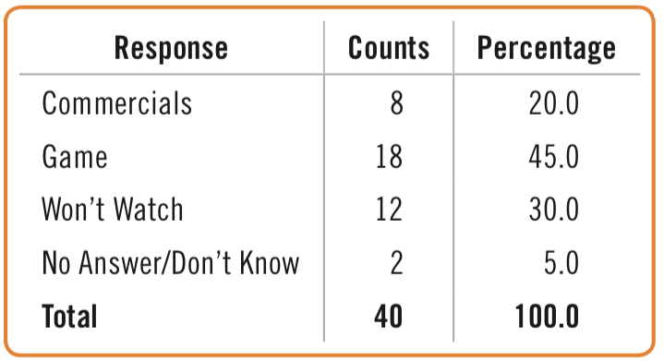
2.1 Summarizing a Categorical Variable
Example: Gaining Insights from Counts
MANAGER What did our survey say about why people watch the Super Bowl?
ANALYST The plurality of respondents said that they watched for the game. Here is a table showing counts and percentages:

Slide 5
2.1 Summarizing a Categorical Variable
Example: Gaining Insights from Counts
MANAGER What did our survey say about why people watch the Super Bowl?
ANALYST The plurality of respondents said that they watched for the game. Here is a table showing counts and percentages:

Slide 6
2.2 Displaying a Categorical Variable
The Three Rules of Data Analysis
To solve a business problem, there are three things you should always do with data:
Make a picture. Exploring your data with a display will reveal things you are not likely to see in a table of numbers.
Make a picture. A well-designed display will do much of the work of analyzing your data. It can help you model your data by showing the important features and patterns.
Make a picture. The best way to report to others what you find in your data is with well-chosen data visualizations.

Slide 7
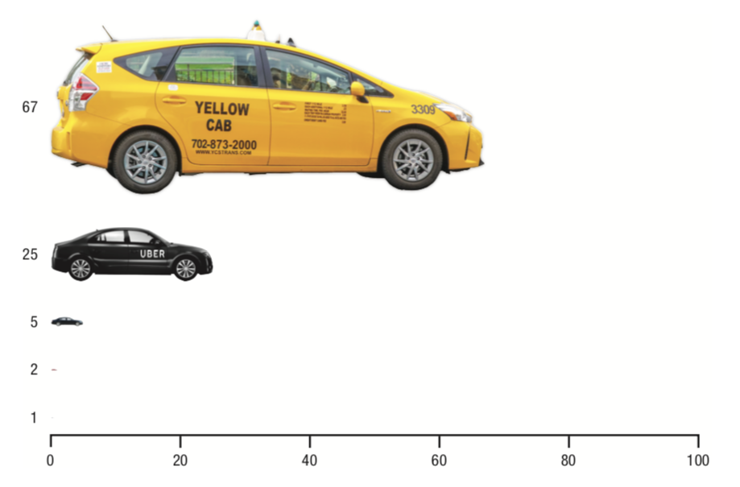
2.2 Displaying a Categorical Variable
The Area Principle
The figure given distorts the data from the frequency table.

Slide 8
2.2 Displaying a Categorical Variable
The Area Principle
The best data displays observe the area principle: the area occupied by a part of the graph should correspond to the magnitude of the value it represents.

Slide 9
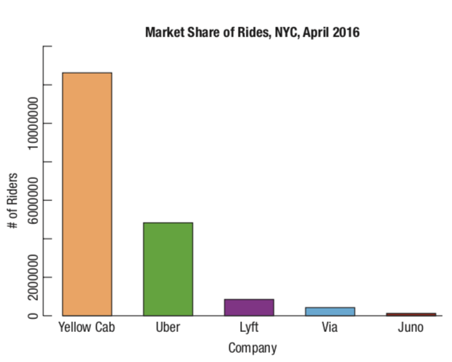
2.2 Displaying a Categorical Variable
Bar Charts
A bar chart displays the distribution of a categorical variable, showing the counts for each category next to each other for easy comparison.
The bar graph here gives a more accurate visual impression of the market share of rides data, though it may not be as visually entertaining.

Slide 10
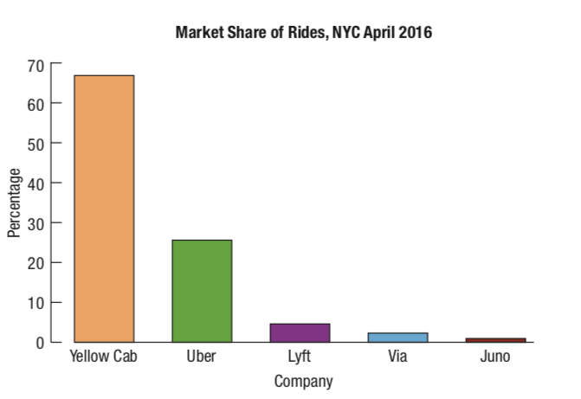
2.2 Displaying a Categorical Variable
Bar Charts
If the counts are replaced with percentages, the data can be displayed in a relative frequency bar chart.
The relative frequency bar chart looks the same as the bar chart, but shows the proportion of visits in each category rather than counts.

Slide 11
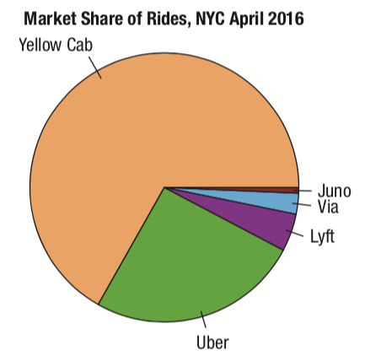
2.2 Displaying a Categorical Variable
Pie Charts
Pie charts show the whole group of cases as a circle sliced into pieces with sizes proportional to the fraction of the whole in each category. The KEEN Inc. data is displayed below.

Slide 12
2.2 Displaying a Categorical Variable
Before making a bar chart or pie chart,
the data must satisfy the Categorical Data Condition: the data are counts or percentages of individuals in categories.
be sure the categories don’t overlap.
consider what you are attempting to communicate about the data.

Slide 13
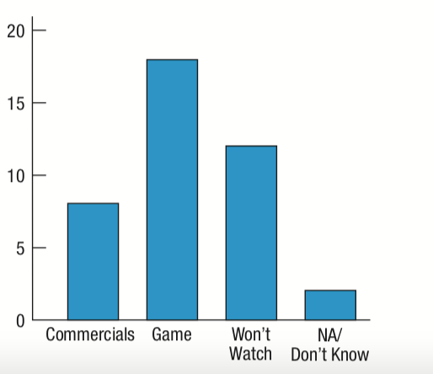
2.2 Displaying a Categorical Variable
Example: Summarizing via bar charts
MANAGER I’m having trouble seeing what the survey data says about the Super Bowl. Can you show me an appropriate display?
ANALYST I used the data from the table to display the counts as heights in the following bar chart. Now it’s very clear that the most frequent response was watching for the game and that about half as many watched for the commercials.

Slide 14
2.3 Exploring Relationships Between Two Categorical Variables:
Contingency Tables
To show how two categorical variables are related, we can create a contingency table.
Contingency tables show how individuals are distributed along each variable depending on the value of the other variable.

Slide 15
2.3 Exploring Relationships Between Two Categorical Variables:
Contingency Tables
The marginal distribution of a variable in a contingency table is the total count that occurs when the value of that variable is held constant.
Each cell of a contingency table gives the count for a combination of values of the two variables.
Rather than displaying the data as counts, a table may display the data as a percentage – as a total percent, row percent, or column percent, which show percentages with respect to the total count, row count, or column count, respectively.

Slide 16
2.3 Exploring Relationships Between Two Categorical Variables:
Contingency Tables
Conditional Distributions
Variables may be restricted to show the distribution for just those cases that satisfy a specified condition. This is called a conditional distribution.
The more interesting questions are contingent on something.
We’d like to know, for example, whether these countries are similar in use and availability of social networking.

Slide 17
2.3 Exploring Relationships Between Two Categorical Variables:
Contingency Tables
Conditional Distributions
Variables may be restricted to show the distribution for just those cases that satisfy a specified condition. This is called a conditional distribution.
The more interesting questions are contingent on something.
We’d like to know, for example, whether these countries are similar in use of the ride-hailing apps.

Slide 18
2.3 Exploring Relationships Between Two Categorical Variables:
Contingency Tables
Conditional Distributions
Variables may be restricted to show the distribution for just those cases that satisfy a specified condition. This is called a conditional distribution.
The more interesting questions are contingent on something.
We’d like to know, for example, whether these countries are similar in use of the ride-hailing apps.

Slide 19
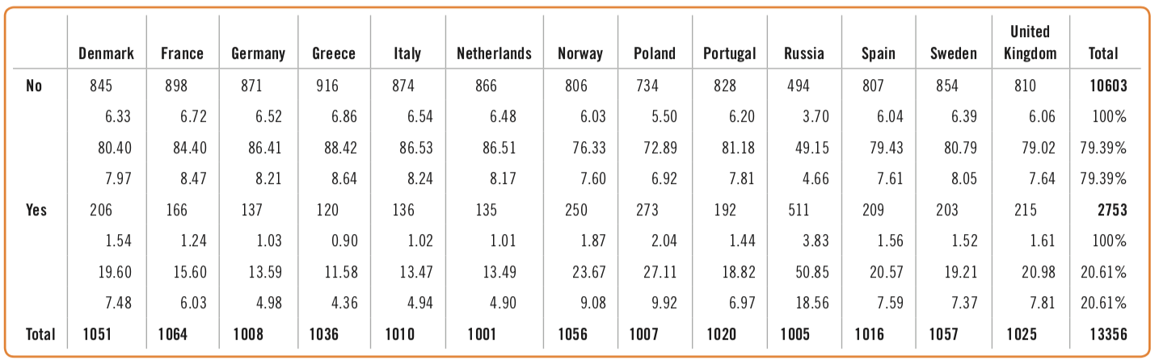
2.3 Exploring Relationships Between Two Categorical Variables:
Contingency Tables
Conditional Distributions
By comparing the frequencies conditional on Country, we can see interesting patterns. For example, by focusing on the tenth column of the table, we can see that Russia stands out as the country that has the highest percentage of people who have used the app.
]

Slide 20
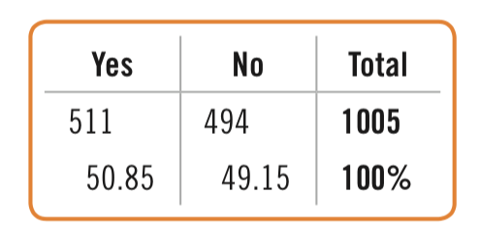
2.3 Exploring Relationships Between Two Categorical Variables:
Contingency Tables
Conditional Distributions
Variables can be related in many ways, so it is typically easier to ask if they are not related.
In a contingency table, when the distribution of one variable is the same for all categories of another variable, we say that the variables are independent.
This tells us there is no association between these variables.

Slide 21
2.4 Segmented Bar Charts and Mosaic Plots
To further visualize conditional distributions, we can create segmented bar charts and mosaic plots.
A segmented bar chart treats each bar as the “whole” and divides it proportionally into segments corresponding to the percentage in each group.
A variant of the segmented bar chart, a mosaic plot, looks like a segmented bar chart, but obeys the area principle better by making the bars proportional to the sizes of the groups.

Slide 22
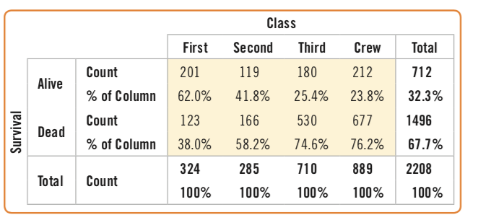
2.4 Segmented Bar Charts and Mosaic Plots
Everyone knows what happened in the North Atlantic on the night of April 14, 1912 as the Titanic, thought by many to be unsinkable, sank, leaving almost 1500 passengers
and crew members on board to meet their icy fate. Here is a contingency table of the 2208 people on board:

Slide 23
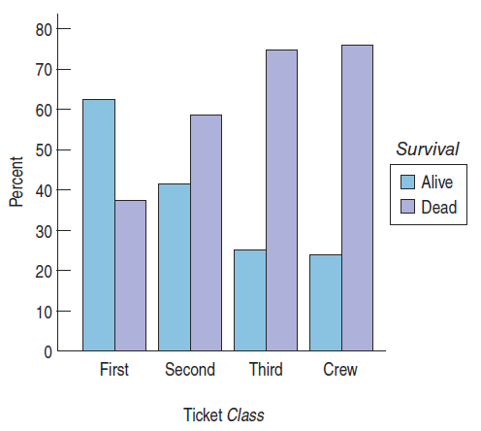
2.4 Segmented Bar Charts and Mosaic Plots
Here is a side-by-side bar chart showing the conditional distribution of Survival for each category of ticket Class:

Slide 24
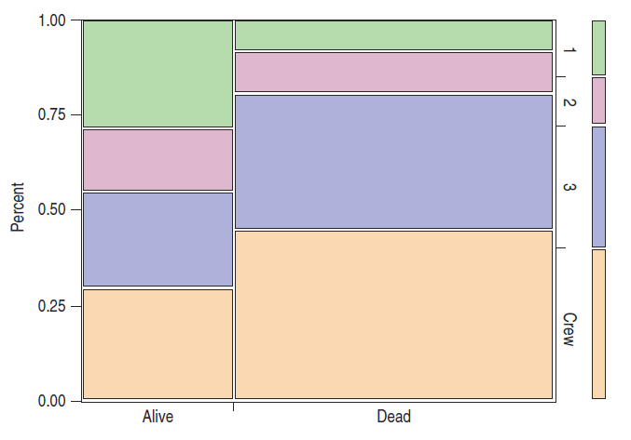
2.4 Segmented Bar Charts and Mosaic Plots
Finally, here is a mosaic plot for Class by Survival.

Slide 25
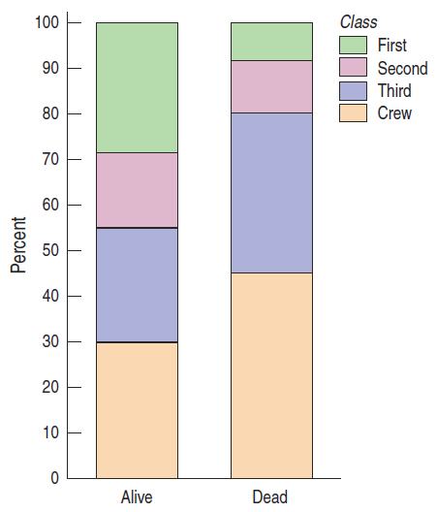
2.4 Segmented Bar Charts and Mosaic Plots
Here is a segmented bar chart. We can clearly see that the distributions of ticket Class are different, indicating again that survival was not independent of ticket class:

Slide 26
2.5 Three Categorical Variables
Studying the relationship between two variables can take us only so far.
If a third variable is involved (as is often the case), the relationship between the first two variables may change depending on the level of the third.
We saw that the Survival rate on the Titanic depended on the Class of steerage, but was the relationship between Survival and Ticket Class the same for men and women?

Slide 27
2.5 Three Categorical Variables
Example: Gaining insight by looking for associations among three variables at once
RESEARCHER I want to show the changing relationship between survival rate and ticket class for the two sexes. What would be some good ways to show this?
ANALYST With three variables we have lot of choices. Because we are most interested in survival rate, we’ll keep that on the vertical axis. First, here are separate bar charts of Survival by Ticket Class for Males and Females.

Slide 28
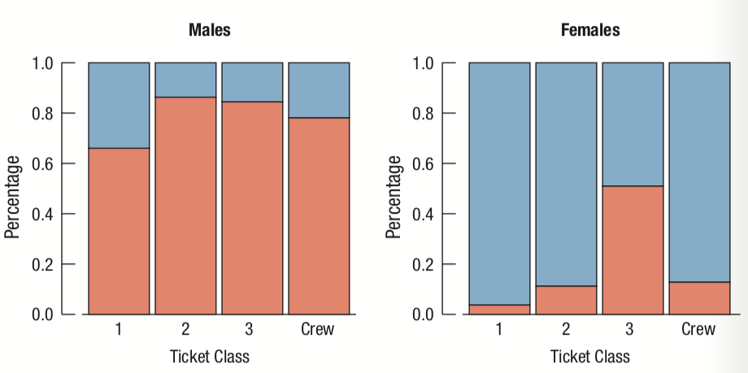
2.5 Three Categorical Variables
Example: Gaining insight by looking for associations among three variables at once

Slide 29
2.5 Three Categorical Variables
Example: Gaining insight by looking for associations among three variables at once
From the separate bar charts, we can see several things. First, it is clear how much higher, in general, the death rates (in orange) were for men, across all ticket classes.
We can also see that the survival rates for men were fairly constant, with slightly higher survival rates for first class and crew.
For women, not only were survival rates much higher, but the only group that suffered significant losses were women with third-class tickets, where the death rate approached 50%.

Slide 30
2.5 Three Categorical Variables
Example: Gaining insight by looking for associations among three variables at once
By placing the bars for men and women side-by-side within each ticket class, we can highlight how different the survival rates were for the two sexes within each ticket class.
For first and second class, and the crew, there were very few women lost, compared to substantial losses for men.
For third class, the difference is smallest, with substantial losses for both sexes.

Slide 31
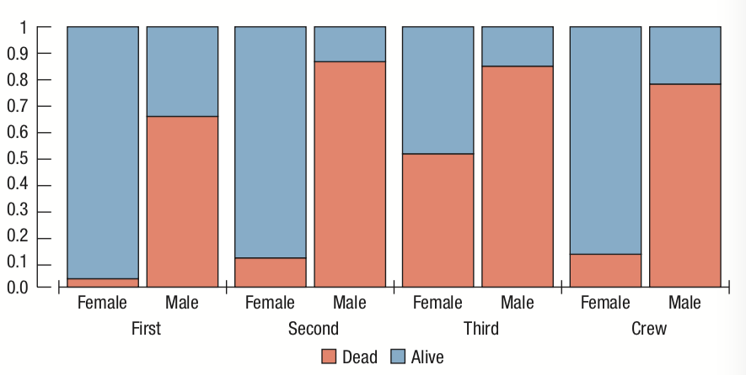
2.5 Three Categorical Variables
Example: Gaining insight by looking for associations among three variables at once

Slide 32
2.5 Three Categorical Variables
Example: Gaining insight by looking for associations among three variables at once
A mosaic plot adds an important piece of information.
Even though most of the women lost held third-class tickets, we can now see that there were far fewer women on board.
By comparing sizes of rectangles, we can see, for instance, that there were about as many women lost in third-class as there were men in first class.

Slide 33
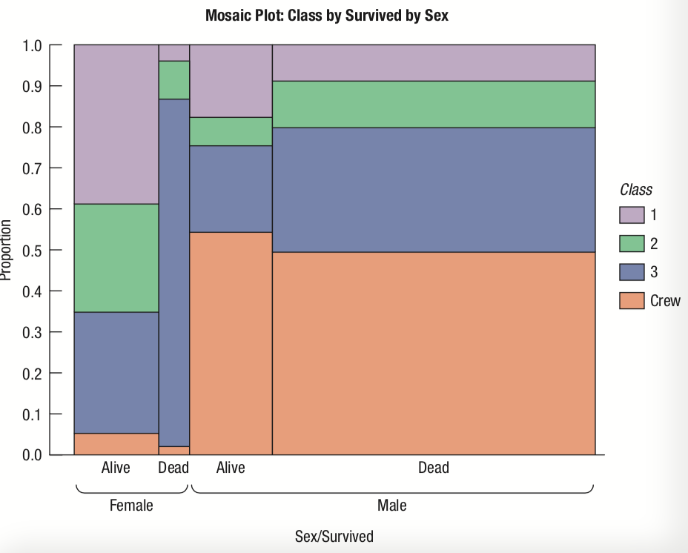
2.5 Three Categorical Variables
Example: Gaining insight by looking for associations among three variables at once

Slide 34
2.6 Simpson’s Paradox
Simpson’s Paradox
Combining percentages across very different values or groups can give confusing results. This is known as Simpson’s Paradox and occurs because percentages are inappropriately combined.

Slide 35
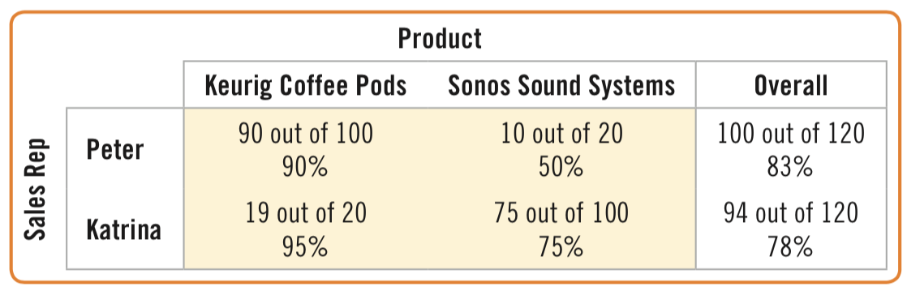
2.6 Simpson’s Paradox
Example: Simpson’s Paradox
Suppose there are two sales representatives, Peter and Katrina. Peter argues that he’s the better salesperson, since he managed to close 83% of his last 120 prospects compared with Katrina’s 78%. Let’s look at the data more closely:

Slide 36
2.6 Simpson’s Paradox
Example: Simpson’s Paradox
Look at the sales of the two products separately. For coffee pod sales, Katrina had a 95% success rate, and Peter only had a 90% rate. When selling sound systems, Katrina closed her sales 75% of the time, but Peter only 50%. So Peter has better “overall” performance, but Katrina is better selling each product. How can this be?

Slide 37
2.6 Simpson’s Paradox
Example: Simpson’s Paradox
This problem is known as Simpson’s Paradox, named for the statistician who described it in the 1960s.
As we can see from the example, the problem results from inappropriately combining percentages of different groups. Katrina concentrates on selling sound systems.
Her overall percentage is heavily influenced by her sound system average. Peter sells more coffee pods, which appear to be easier to sell.
With their different patterns of selling, taking an overall percentage is misleading.

Slide 38
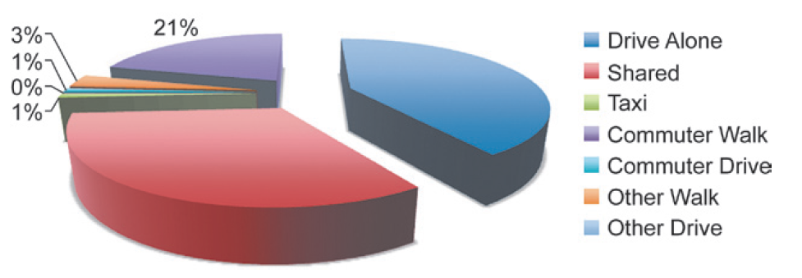
WHAT CAN GO WRONG?
Don’t violate the area principle. “Shared” rides is actually 33%.

Slide 39
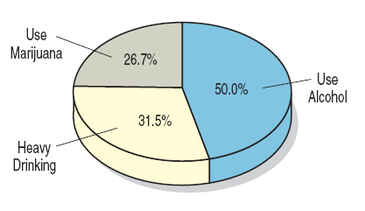
WHAT CAN GO WRONG?
Keep it honest.
  The pie chart below is confusing because the percentages add up to more than 100% and the 50% piece of pie looks smaller than 50%.

Slide 40
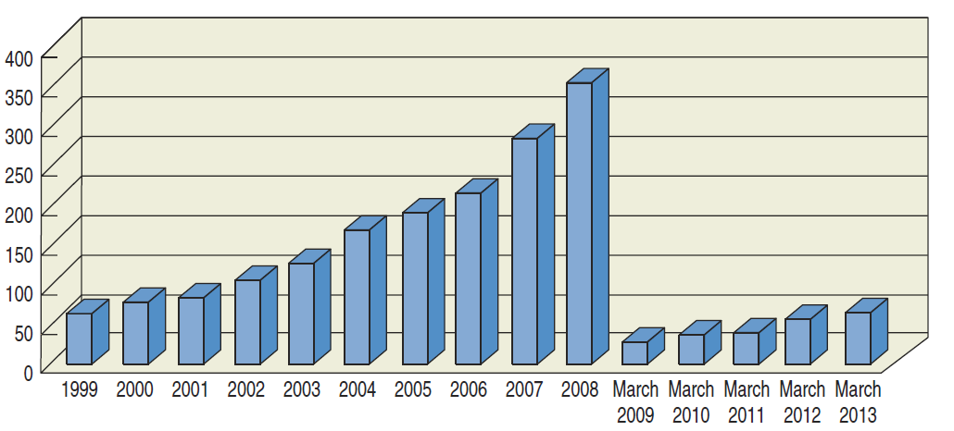
WHAT CAN GO WRONG?
Keep it honest.
  The scale of the years change from one-year increments to one-month increments. This is misleading.

Slide 41
WHAT CAN GO WRONG?
Don’t confuse percentages – differences in what a percentage represents needs to be clearly identified.
Don’t forget to look at the variables separately in contingency tables and through marginal distributions.
Be sure to use enough individuals in gathering data.
Don’t overstate your case. You can only conclude what your data suggests. Other studies under other circumstances may find different results.

Slide 42
WHAT CAN GO WRONG?
Don’t confuse percentages – differences in what a percentage represents needs to be clearly identified.
Don’t forget to look at the variables separately in contingency tables and through marginal distributions.
Be sure to use enough individuals in gathering data.
Don’t overstate your case. You can only conclude what your data suggests. Other studies under other circumstances may find different results.

Slide 43
FROM LEARNING TO EARNING
Make and interpret a frequency table for a categorical variable.
    We can summarize categorical data by counting the number of cases in each category, sometimes expressing the resulting distribution as percentages.
Make and interpret a bar chart or pie chart.
    We display categorical data using the area principle in either a bar chart or a pie chart.
Make and interpret a contingency table.
    When we want to see how two categorical variables are related, we put the counts (and/or percentages) in a two-way table called a contingency table.

Slide 44
FROM LEARNING TO EARNING
Make and interpret bar charts and pie charts of marginal distributions.
  We look at the marginal distribution of each variable (found in the margins of the table). We also look at the conditional distribution of a variable within each category of the other variable.
  Comparing conditional distributions of one variable across categories of another tells us about the association between variables. If the conditional distributions of one variable are (roughly) the same for every category of the other, the variables are independent.

Slide 45
FROM LEARNING TO EARNING
Make and interpret graphical displays for contingency tables.
  Bar charts (segmented or side-by-side) show the percentages or counts for the values of one variable conditional on the values of another.
  Mosaic plots represent the values in a contingency table because each rectangle is proportional to the number of cases in that cell of the table.

Slide 46
FROM LEARNING TO EARNING
Make and interpret graphical displays for contingency tables.
  Bar charts (segmented or side-by-side) show the percentages or counts for the values of one variable conditional on the values of another.
  Mosaic plots represent the values in a contingency table because each rectangle is proportional to the number of cases in that cell of the table.

